Slide 1
CEG 4750/6750 Midterm Review
Notes:
Zili Shao

Slide 2
Time and Location
All students will take the online exam.
  the exam will be available Feb 28th, 2025 (Friday), 10:00AM to 10:00PM, EST
  You will have 80 minutes to finish the midterm exam.
  Students registered with the disability office will have 120 minutes.

Slide 3
Exam for In-class / Online Sections
Click on the Assessment tab in the course and select Quizzes and Exams.
On the Quizzes and Exams page, click on the the title “Midterm Exam.”
You will use a lockdown browser.

Slide 4
Policy
This is a close-book midterm
Students are allowed to carry a cheat sheet hand-written on a 4' by 6' note card (double sides)
Calculators with basic operation support (+/-/*/division) are permitted
You have totally 80 minutes with a grace period of 5 minutes
You are not allowed to collaborate with other students during the exam
No aid given, received, or observed.
Please make sure your handwriting is legible
If your answers are not legible, you will lose points for them
You will be given credits only for what appears on your exam.

Slide 5
Questions
Questions
  True/False
  Multiple choices
  Filling blanks
  Short questions
  Computation questions

Slide 6
Topics
All topics from Week 1 – 7
  Classical Encryption Techniques
  Block ciphers and Stream ciphers
  DES (Data Encryption Standard)
  Block Cipher Mode of Operations
  Basic Number Theory
  Feimat’s Little Theorem
  Euler’s Theorem

Slide 7
Basic Methods of Symmetric Encryption
1. Substitution:
Noclasstoday→ optmbttupebz
2. Transposition: rearrange the sequence of the plaintext
Noclasstoday→ ncossaolstdy
3. Product: Multiple stages of Substitution and Transposition
CEG 260, Meilin Liu
Notes:
Zili Shao

Slide 8
Classical Cryptosystems
Shift Cipher
Playfair Cipher
Hill Cipher
Vigenere cipher
One-time pad (Vernam Cipher)
Transposition Ciphers: Rail Fence cipher, Row Transposition Ciphers
Product Ciphers: Rotor Machines
CEG 260, Meilin Liu
Notes:
Zili Shao

Slide 9
Block vs Stream Ciphers
Block ciphers process messages in blocks, each of which is then en/decrypted
Like a substitution on very big characters
  64-bits or more
Stream ciphers process messages a bit or byte at a time when en/decrypting
Many modern ciphers are block ciphers
CEG 260, Meilin Liu
Notes:
Zili Shao
Block ciphers work a on block / word at a time, which is some number of bits. All of these bits have to be available before the block can be processed. Stream ciphers work on a bit or byte of the message at a time, hence process it as a “stream”.

Slide 10
One-Time Pad
A block cipher treats a block of plaintext as a whole and encrypts it to produce a ciphertext block of equal length.
A stream cipher encrypts digital data one bit at a time, typically by xoring it bit by bit with a key stream.
The one-time pad, which is a provably secure cryptosystem,
was developed by Gilbert Vernam in 1918.
The key:
  Truly random
  the same length as the message
  used one time only

Slide 11
Data Encryption Standard (DES)
Most widely used block cipher in world
Adopted in 1977 by NBS (now NIST)
  as FIPS PUB 46
Encrypts 64-bit data using 56-bit key
Has widespread use
Has been considerable controversy over its security
Easy in hardware, slow in software
CEG 260, Meilin Liu
Notes:
Zili Shao

Slide 12
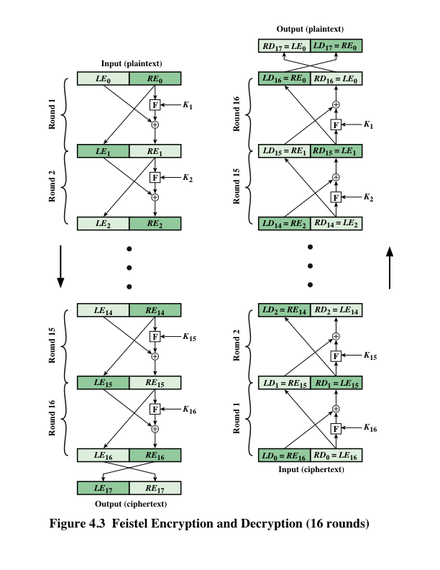
DES – Feistel Structure
Li=Ri-1; Ri=Li-1 XOR F(Ri-1, Ki)
CEG 260, Meilin Liu
Notes:
Zili Shao

Slide 13
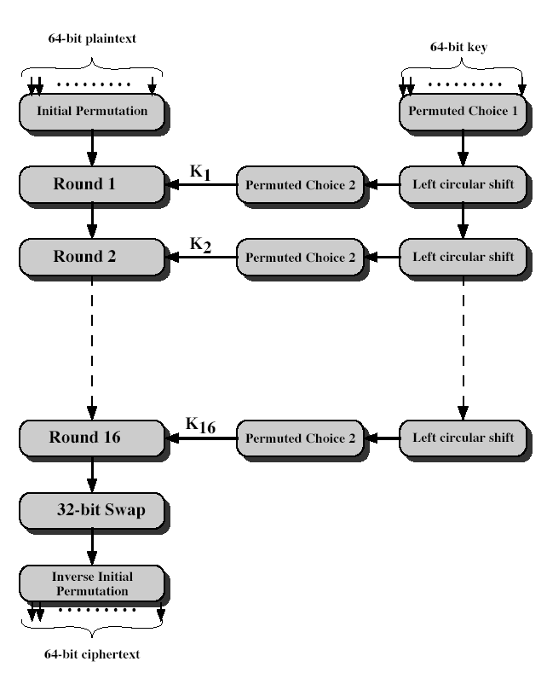
DES Encryption
CEG 260, Meilin Liu
Notes:
Zili Shao
The basic process in enciphering a 64-bit data block using the DES, shown on the left side, consists of:
- an initial permutation (IP)
- 16 rounds of a complex key dependent round function involving substitution and permutation functions
- a final permutation, being the inverse of IP
The right side shows the handling of the 56-bit key and consists of:
- an initial permutation of the key (PC1) which selects 56-bits in two 28-bit halves
- 16 stages to generate the subkeys using a left circular shift and a permutation

Slide 14
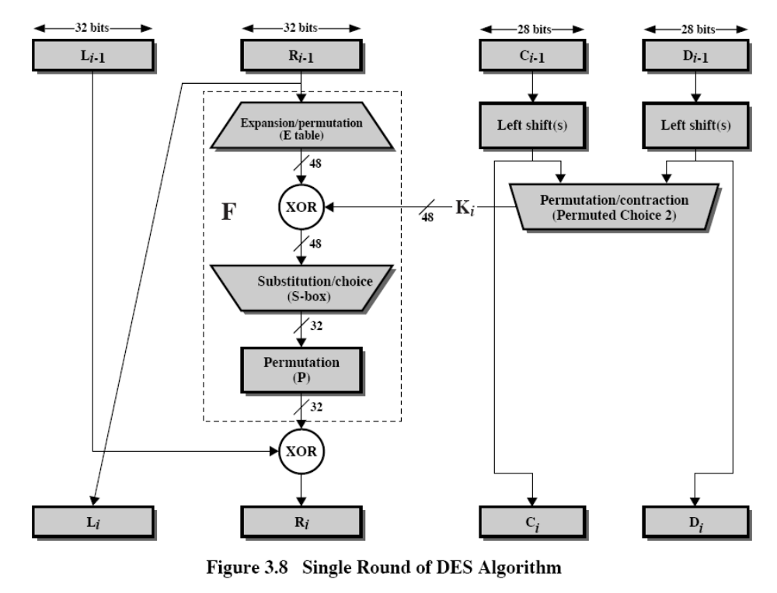
DES Single Round
CEG 260, Meilin Liu
Notes:
Zili Shao
Note that the s-boxes provide the “confusion” of data and key values, whilst the permutation P then spreads this as widely as possible, so each S-box output affects as many S-box inputs in the next round as possible, giving “diffusion”.

Slide 15
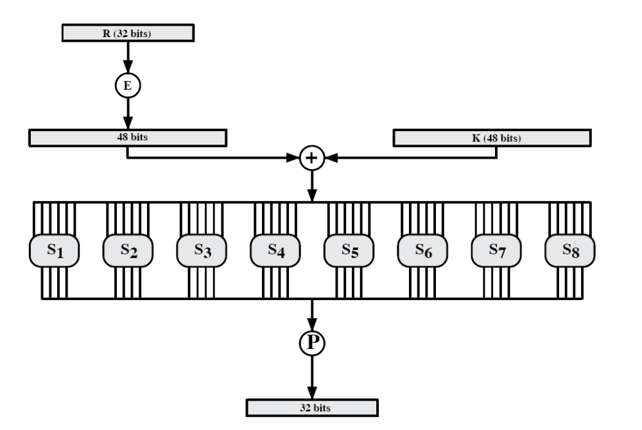
F-function
CEG 260, Meilin Liu
Notes:
Zili Shao

Slide 16
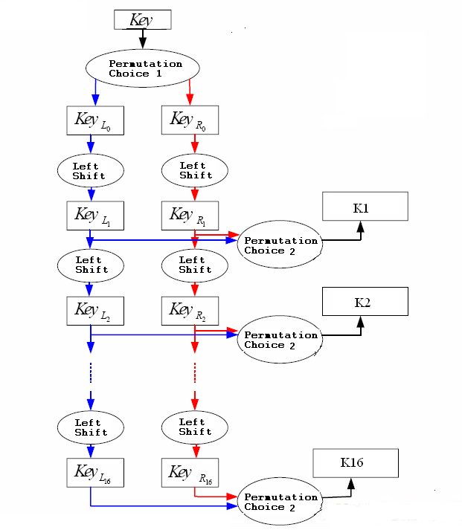
Key Generator
CEG 260, Meilin Liu
Notes:
Zili Shao

Slide 17
Double-DES
Could use 2 DES encrypts on each block
  C = E(K1, E(K2, P))
Have “meet-in-the-middle” attack
  works whenever use a cipher twice
  since X = E(K2, P) = D(K1,C)
  Pre-compute table of E(K1, P) for every possible key K1 (resulting table has 2^56 entries)
  Then for each possible K2 compute D(K2, C) until a match in table is found
  When match is found, have E(K2, P) = D(K1, C)
  Result gives us keys: C = E(K1, E(K2, P))
CEG 260, Meilin Liu
Notes:
Zili Shao
The simplest form of multiple encryption has two encryption stages and two keys - Double-DES.
Have concern that there might be a single key that is equivalent to using 2 keys as above, not likely but only finally proved in 1992.
More seriously have the “meet-in-the-middle” attack, first described by Diffie in 1977. It is a known plaintext attack (ie have know pair (P,C), and attempts to find by trial-and-error a value X in the “middle” of the double-DES encryption of this pair, and chances of this are much better at O(2^56) than exhaustive search at O(2^112).

Slide 18
Why not double DES?
Define 2E( (k₁,k₂), m) = E(k₁ , E(k₂ , m) )
Attack: Given M = (m₁,…, m₁₀) , C = (c₁,…,c₁₀).
  Find (K1, K2) such that C = E(K1, E(K2, P)) Or E(K2, P) = D(K1, C)
E(k₂,⋅)
E(k₁,⋅)
key-len = 112 bits for DES
m
c

Slide 19
Meet in the middle attack
E(k₂,⋅)
E(k₁,⋅)
m
c
Time = 2⁵⁶log(2⁵⁶) + 2⁵⁶log(2⁵⁶) < 2⁶³ << 2¹¹² , space ≈ 2⁵⁶
Build the table, sort
on the second column
After applying decryption with a key,
search the result in the table

Slide 20
Strengthening DES against ex. search
Triple-DES
Let E : K × M ⟶ M be a block cipher
Define 3E: K³ × M ⟶ M as
For 3DES: key-size = 3×56 = 168 bits. 3×slower than DES.
(simple attack in time ≈2¹¹⁸ )
3E( (K1,K2,K3), m) = E(K1, D(K2, E(K3, m) ) )

Slide 21
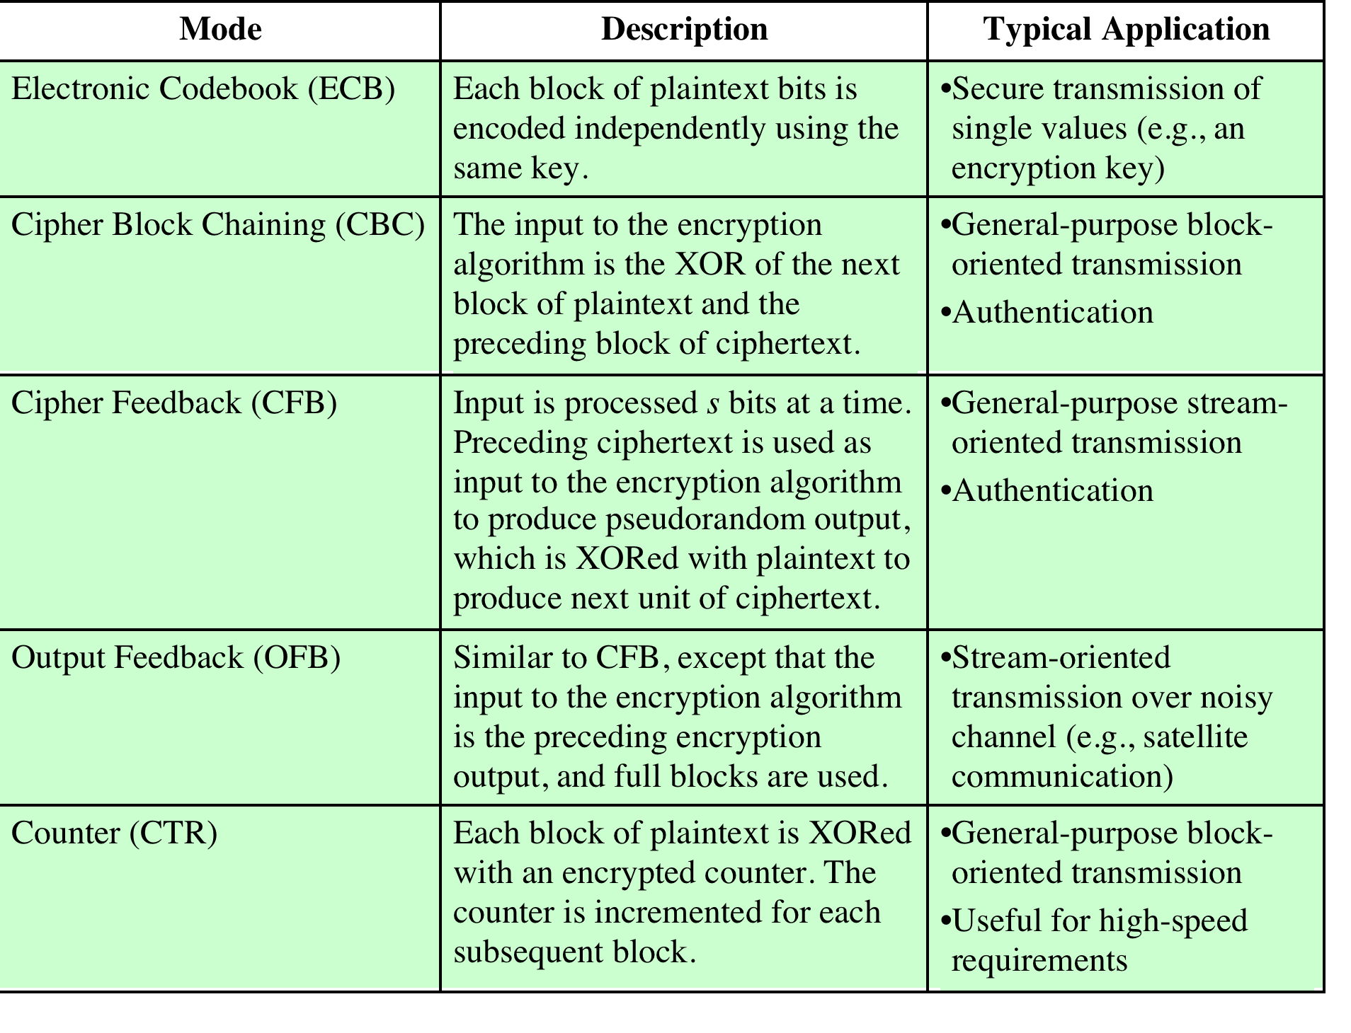
Notes:
The modes are summarized in Table 6.1 and described in this and the following sections.

Slide 22
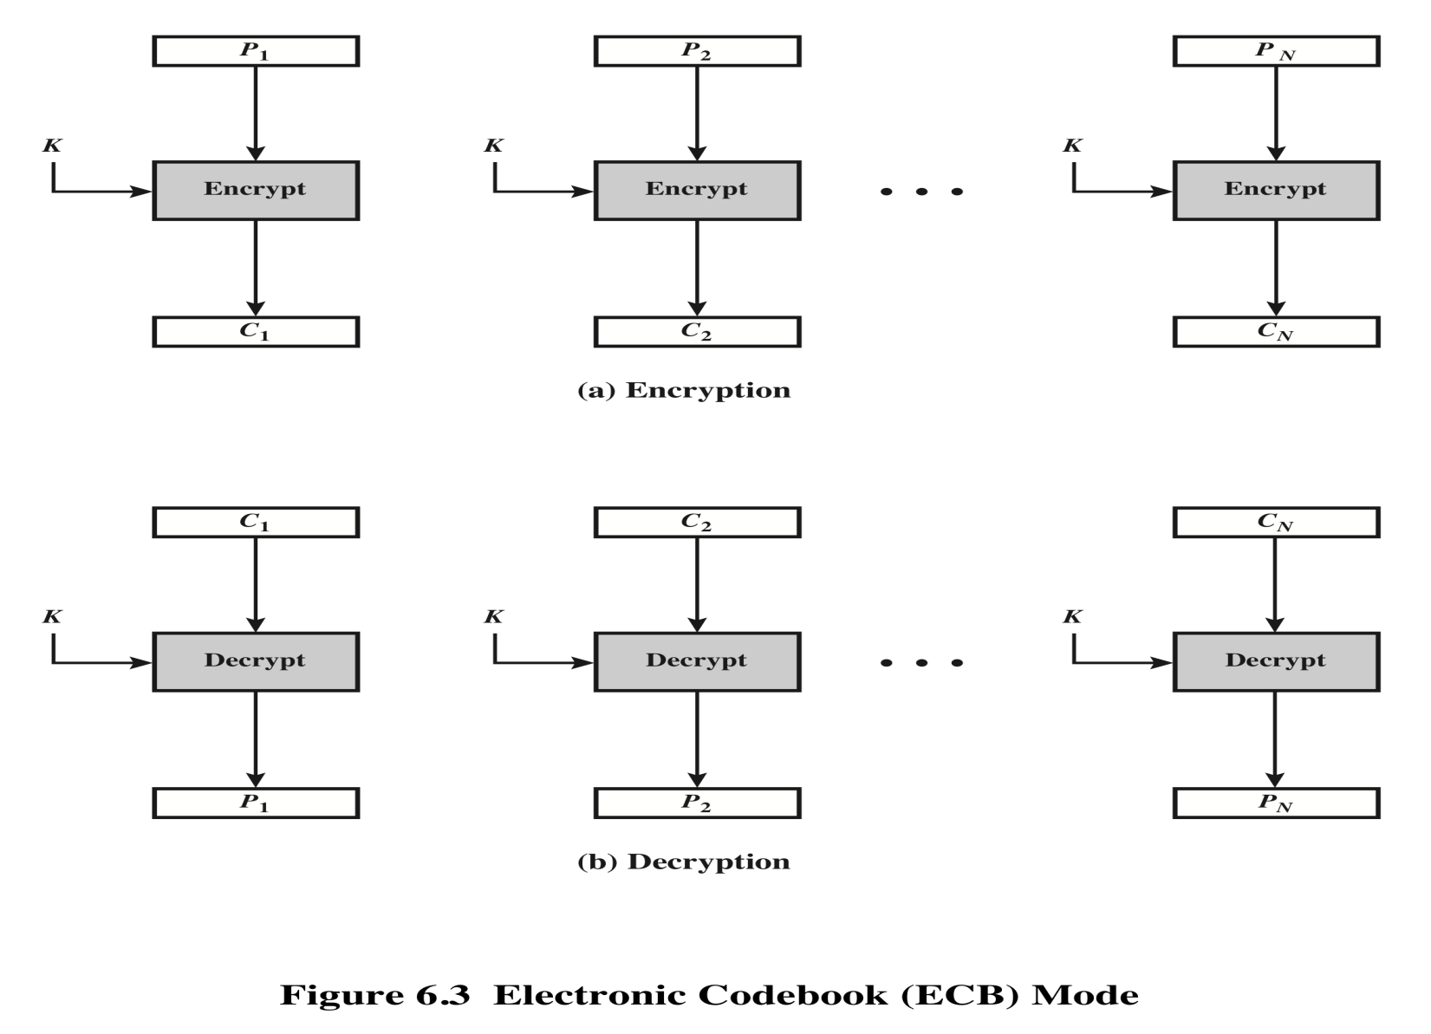
Electronic Codebook Mode (ECB)

Slide 23
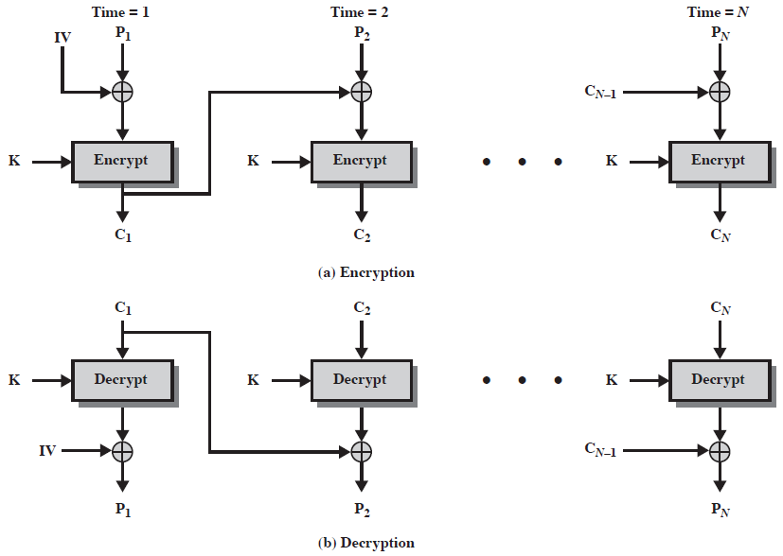
Cipher Block Chaining (CBC)

Slide 24
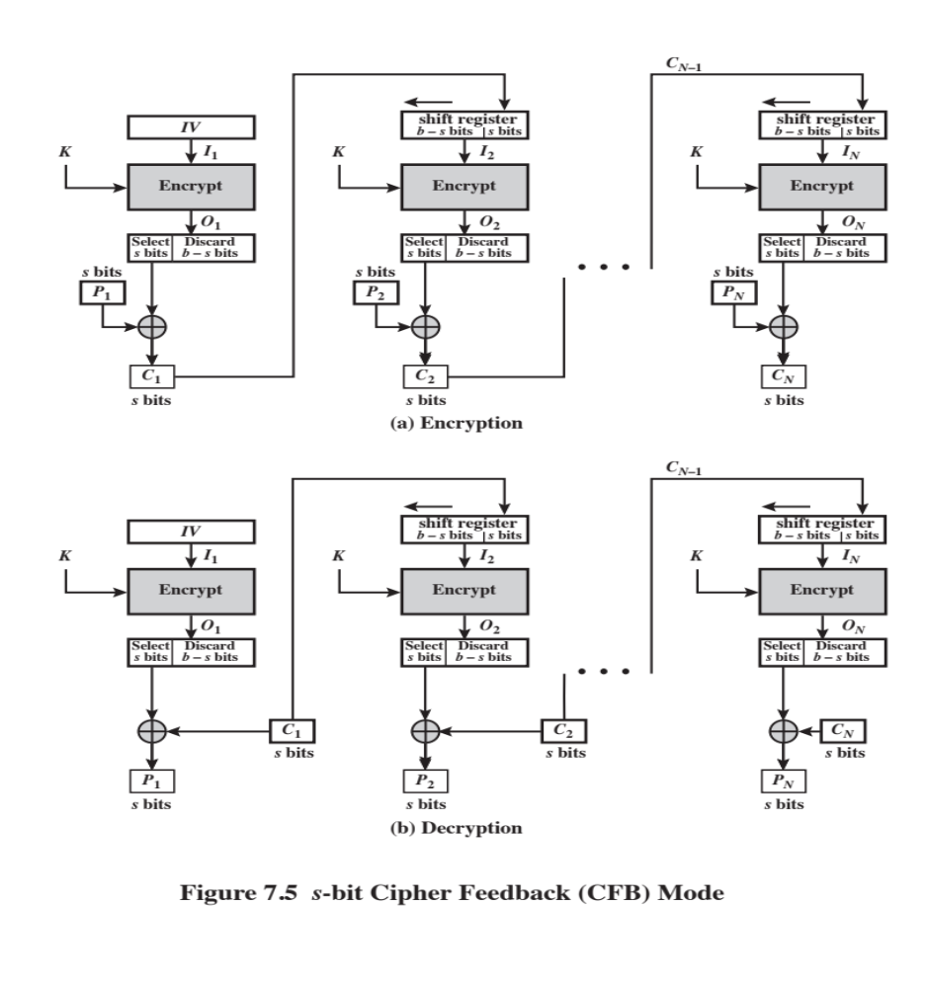
Cipher FeedBack (CFB)
CEG 260, Meilin Liu
Notes:
Zili Shao
Stallings Fig 3.13

Slide 25
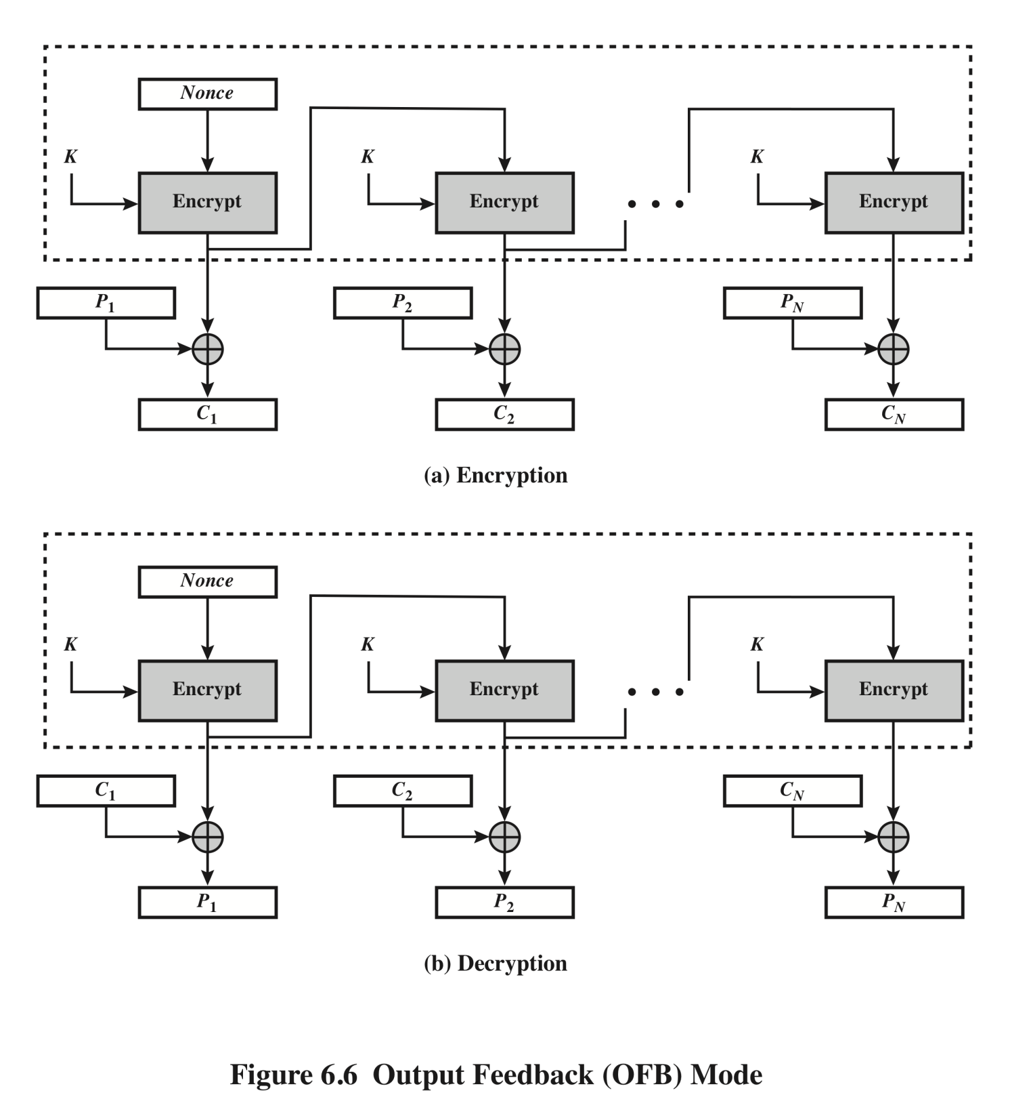
Output Feedback (OFB)
Mode

Slide 26
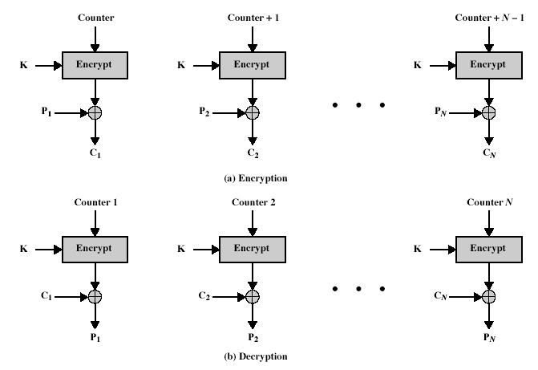
Counter (CTR)
CEG 260, Meilin Liu
Notes:
Zili Shao
Stallings Fig 3.15

Slide 27
Modular Arithmetic
In integer arithmetic, if we divide a by n, we can get quotient q and remainder r. The relationship between these four integers can be shown as
  a= q*n+r
Here, we call a the dividend; n, the divisor; q, the quotient; and r, the remainder.
Modulo operator for a positive integer n
  r = a mod n
equivalent to
  a = r + q*n
In Cryptograph, we need to impose two restrictions. First, we require that the divisor be a positive integer (n>0). Second, we require that the remainder be a nonnegative integer (r>=0).
Example:
  29 mod 13 = 3 13 mod 13 = 0 -1 mod 13 = 12
  29 = 3 + 2*13 13 = 0 + 1*13 12 = -1 + 1*13
CEG 260, Meilin Liu
Notes:
Zili Shao
All security policies and mechanisms rest on assumptions; we’ll examine some in later chapters, most notably Chapter 22, Malicious Logic. Here is a taste of the assumptions.
Policies: as these define security, they have to define security correctly for the particular site. For example, a web site has to be available, but if the security policy does not mention availability, the definition of security is inappropriate for the site. Also, a policy may not specify whether a particular state is “secure” or “non-secure.” This ambiguity causes problems.
Mechanisms: as these enforce policy, they must be appropriate. For example, cryptography does not assure availability, so using cryptography in the above situation won’t work. Further, security mechanisms rely on supporting infrastructure, such as compilers, libraries, the hardware, and networks to work correctly. Ken Thompson’s modified C preprocessor (see the example on p. 615) illustrates this point very well.

Slide 28
Congruent Modulo
Integers: Z ={…,-3,-2,-1,0,1,2,3,…}
Modulo n operation partition the integers into n sets
Z_{n}={0,1,…,n-1}
Z₃={0,1,2} represents 3 sets
0 represent a residue class
Z_{n}*= {1≤ b < n | gcd(b,n)=1}
CEG 260, Meilin Liu
Notes:
Zili Shao

Slide 29
Greatest Common Divisor
The greatest common divisor (GCD) of two positive integers a and b, denoted gcd(a, b), is the largest positive integer that divides both a and b
The above definition is extended to arbitrary integers
Examples:
  gcd(18, 30) = 6
  gcd(0, 20) = 20
  gcd(-21, 49) = 7
Two integers a and b are said to be relatively prime if
  gcd(a, b) = 1
Example:
  Integers 15 and 28 are relatively prime
CEG 260, Meilin Liu
Notes:
Zili Shao

Slide 30
Multiplicative Inverses
The residues modulo a positive integer n are the set
  Zn = {0, 1, 2, …, (n - 1)}, i.e., Zn = {x| 0≤x ≤ n-1, where x is a positive integer}.
Let Zn* = {x| 1≤x ≤ n-1, where GCD(x, n)=1, and x is a positive integer}
Zn* is the subset of elements of Zn relative prime with n or the set of invertible elements in Zn.
Examples:
for prime p, Zp* = {1,2,3,...,p-1}
CEG 260, Meilin Liu
Notes:
Zili Shao

Slide 31
Multiplicative Inverses
The multiplicative inverse of a modulo m exists iff a and m are coprime (i.e., if gcd(a, m) = 1).
The modular multiplicative inverse of a modulo m, is an integer x belongs to Zm*, such that a*x =1 (mod m).
If the modular multiplicative inverse of a modulo m exists, the operation of division by a modulo m can be defined as multiplying by the inverse, i.e., b/a mod m =b*(a^-1) mod m, Here a^-1 is a’s multiplicative inverse.
CEG 260, Meilin Liu
Notes:
Zili Shao

Slide 32
Multiplicative Inverses
Theorem: a has a multiplicative inverse modulo m, if and only if a is relative prime to m, i.e., GCD(a,m)=1.
Example: 3*x=1 mod 7, x = 1/3
x=5, 3*5 mod 7 = 15 mod 7=1
1/3 mod 7 =5, since 5*3=1 mod 7
CEG 260, Meilin Liu
Notes:
Zili Shao

Slide 33
Fermat’s Little Theorem -- Application
Theorem
  If p is prime and a is a positive integer not divisible by p, i.e., GCD(a,p)=1, then a^ (p-1) ==1 mod p.
  Application: This can be used to compute the multiplicative inverse for a prime number p, and for an integer a less than p.
    a * x mod p =1, and we know a^ (p-1) ==1 mod p.
    x = a^ (p-2) mod p
  Application: generating random primes
    test if 2^{p-1} mod p = 1, Pr[ p not prime ] < 2⁻⁶⁰
    Carmichael number: a composite n such that for all a in Zn*, a^(n-1) = 1 mod n. (e.g., 561, 1729)
CEG 260, Meilin Liu
Notes:
Zili Shao

Slide 34
Euler’s Theorem
Suppose a is relatively prime to n, where a, n is an integer,
Then a^(φ(n))= 1 (mod n).
Examples: 5^φ(12) mod 12 = 5^4 mod 12 = 625 mod 12 = 1 3^φ(10)mod 10 = 3^4 mod 10 = 81 mod 10=1
7^φ(10)mod 10 = 7^4 mod 10 = 2401 mod 10=1
Generalization of Fermat. Basis of the RSA cryptosystem
Suppose a is relatively prime to n, where a, n is an integer,
Then a^(k*φ(n)+1)= a (mod n).
CEG 260, Meilin Liu
Notes:
Zili Shao

